Slide 1
ECLI 2.0
| Athens| 08-06-2017
Monica Palmirani, University of Bologna
Fabio Vitali, University of Bologna
Marc van Opijnen, UBR|KOOP
Jos van den Oever, UBR|KOOP
Tommaso Agnoloni, ITTG-CNR
This project is co-funded by
the European Union
Notes:
Please, fill in the Title in one or two lines,
as the place and date of the event.

Slide 2
ECLI 1.0
It has been a methodology for creating a common, flexible, customizable local naming convention for the identifiers of judgments at an abstract level.
Additionally it has defined a common metadata framework.
Each Member State has needed to define its local ECLI identifier syntax and to decide on the minimal dataset to adopt.
It has clearly been a great success!

Slide 3
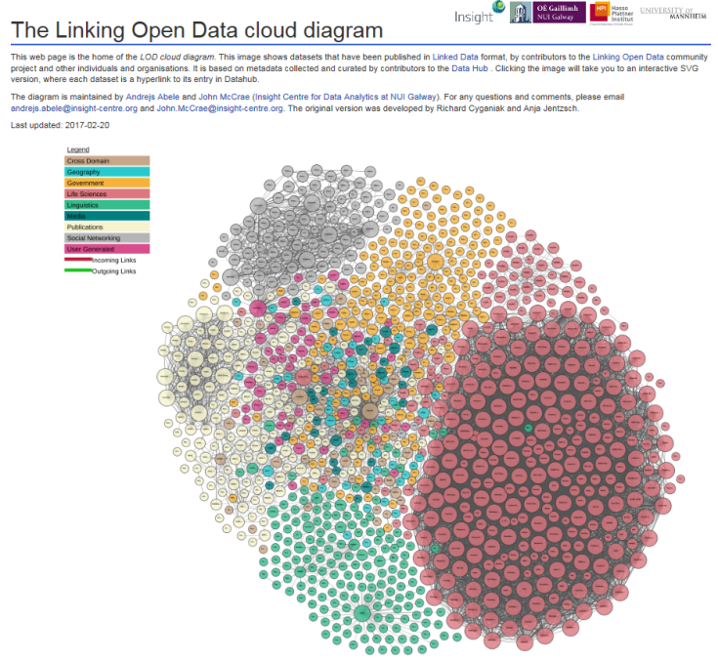
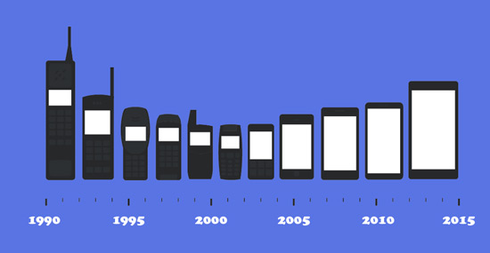
Evolution of a success as an Extension: ECLI 2.0
ECLI 2.0
ECLI 1.0

Slide 4
Scenario 1
An Italian judge wants to refer to a judgment of the Court of Justice of the European Union —CJEU, but only to the version in Italian because this is the only language eligible for Italian courts.
ECLI 1.0 does not allow to refer to an individual version of a judgment in a given language.
1.0
ECLI:EU:C:2014:317
2.0
ECLI:EU:C:2014:317(:ITA)

Slide 5
Scenario 2
A publishing house creates its own special anonymized collection of heterogeneous judgments, with editorial footnotes.
Scholars want to cite not just the judgment, but the judgement as published by the publishing house.
ECLI 1.0 does not allow to distinguish the original version from edited version
ECLI:EU:C:2014:317
1.0
2.0
ECLI:EU:C:2014:317(:KLW)

Slide 6
Scenario 3
A scientific paper wants to make a precise citation to a specific paragraph of the judgment that includes a particular rule of law, really significant for the legal community.
ECLI 1.0 does not allow to refer to specific fragment of the document.
ECLI:EU:C:2014:317
1.0
2.0
ECLI:EU:C:2014:317#para99

Slide 7
Stakeholders survey
Questionnaires were collected from 28 Member States and from 3 EU courts: the Court of Justice of the European Union —CJEU—, the European Court of Human Rights —ECtHR— and the Boards of Appeal of the European Patent Organization —EPO.
The questionnaire included five sections: i) on the publication process; ii) on data protection policy; iii) on open data strategy; iv) on citation patterns; v) on ECLI adoption.
Additionally analysis was conducted about the current state of the art.
Two deliverables were produced which are now available on the BO-ECLI web portal.

Slide 8
WHY ECLI 2.0
3°
4°
5°
Six issues were detected:
Mixed information within the fifth element
Length of the third element is too limited
Unclear subdivision of the information between the elements
Need for representation of fragments when the citation points to portions of the text
Need for an HTTP-URI syntax for uses in Linked Open Data environments
Need for a query language to help the communication between API implementations
1°
2°
ECLI:
country code:
code of
the court:
year:
ordinal
number

Slide 9
Benefits of ECLI 2.0
Total backward compatibility with ECLI 1.0.
Harmonization of the syntax for situations at the moment managed with custom technical solutions.
Extensibility of the standard for long-term application of the specifications.
Precision of the details.
Clear distinction between the authentic documents and the versions managed by the commercial publishers.
Compatibility with Linked Data tools and applications.

Slide 10
1. Mixed information within the fifth element
Fundamental principles of ECLI identifier are
uniqueness,
usability,
interoperability among different judiciary system practices,
clearness and
transparency of each part.
Some national legal practices use the number case in the identifier and extra information are routinely included in the fifth element.
ECLI 1.0 ECLI:CE:ECHR:1993:0422JUD001507089
ECLI 2.0 ECLI:CE:ECHR:19930422:JUD001507089
ECLI 1.0 ECLI:DE:BVerwG:2014:060314B9C6.12.0
ECLI 2.0 ECLI:DE:BVerwG:20140306:B9C6.12.0
ECLI 1.0 ECLI:FR:CESSR:2014:351618.20140326
ECLI 2.0 ECLI:FR:CESSR:20140326:351618.

Slide 11
2. Length of the third element is too limited
Several countries need more than seven characters for expressing the court code in order to be closer with their judiciary system citation tradition.
ECLI 2.0 extends the maximum allowable length of the third element from 7 to 12 characters (only when necessary).

Slide 12
3. Unclear subdivision of the information between the elements
Several existing legal standards (e.g., ELI, AKN) already use the FRBR model to clearly organize the legal information
ECLI 1.0 does not discriminate between temporal versions, linguistic variants and/or editorial variants of a text
ECLI 2.0 aims to provide a robust and harmonized method for managing these variants, especially:
To distinguish between authorial documents and edited ones generated by commercial publication processes (EDITORIAL variants)
To identify LANGUAGE variants of the same judgment
To refer to the correct CONTENT versions in case of errors/corrigenda

Slide 13
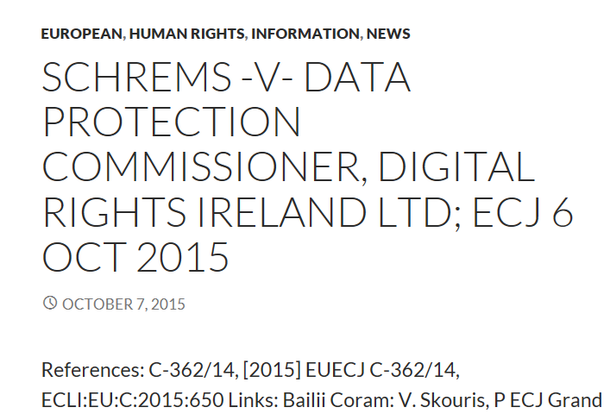
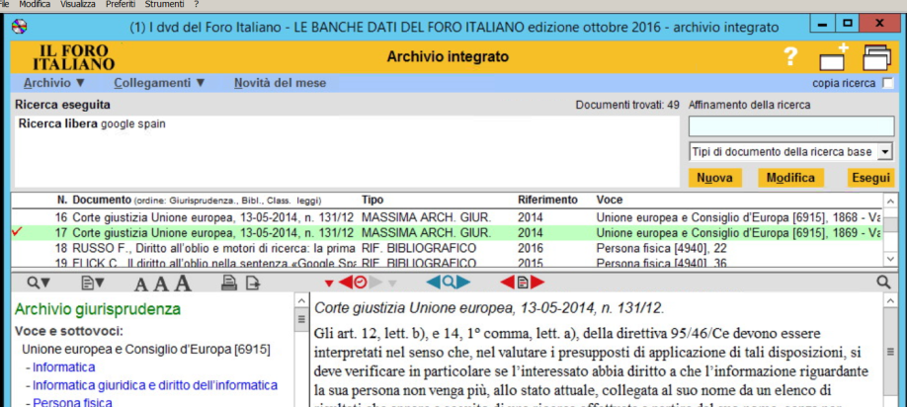
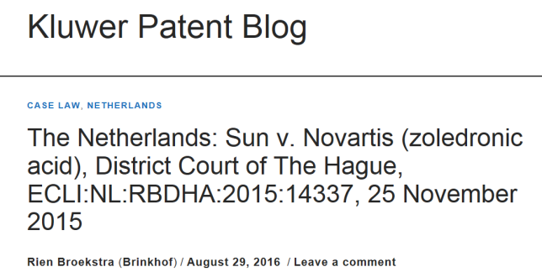
3.1 Editorial variants
Editoral variants are increasing in the commercial publishing market. It is recommanded to distinguish between the different editoral variants
ECLI: ECLI:EU:C:2015:650(:KLW)

Slide 14
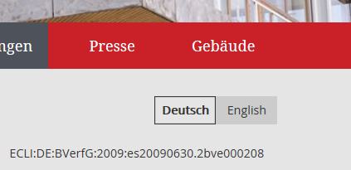
3.2 Language variants
CELLAR of Publication Office
<IDENTIFIER>ECLI:EU:C:2003:333.HRV</IDENTIFIER>
http://publications.europa.eu/resource/ecli/ECLI%3AEU%3AC%3A2003%3A333.HRV
http://www.bundesverfassungsgericht.de/SharedDocs/Entscheidungen/DE/2009/06/es20090630_2bve000208.html
http://www.bundesverfassungsgericht.de/SharedDocs/Entscheidungen/EN/2009/06/es20090630_2bve000208en.html
http://data.finlex.fi/oikeus/ECLI:FI:KKO:2001:51/swe
ECLI 1.0 ECLI:FI:KKO:2001:51
ECLI 2.0 ECLI:FI:KKO:2001:51(:swe)

Slide 15
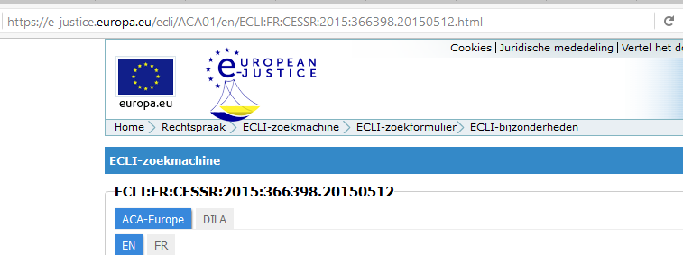
3.3 Language and Editor Specifications
https://e-justice.europa.eu/ecli/eu/c/2014/317(aca/v1/esp)(.html)
E-Justice
Working Party
31-01-2017
Brussels
15
Notes:
Feel free to manage – design – arrange your content in one, two or more columns at the above two rectangular areas!

Slide 16
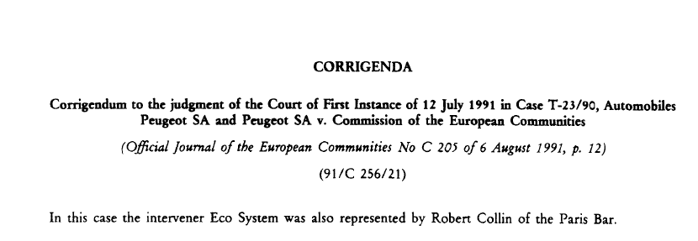
3.3 Versions over time
It is infrequent to have versions of the same text over time, but sometimes they do happen
ECLI:EU:C:2014:317(:ACA:ESP:V1)
ECLI 1.0 ECLI:CZ:NS:2016:33.CDO.4581.2015.1
ECLI 2.0 ECLI:CZ:NS:2016:33.CDO.4581.2015 (:V1)

Slide 17
4. Representation of fragments
Fragment representation when the citation identifies a portion of the text
Sometimes the decision citations includes also fragment
In order to define a common standard also for this additional part of the reference it is very helpful to provide a mechanism to increase the precision of the technical dereferencing system
ECLI:EU:C:2014:238(:ACA:ITA:V1)#part53
ECLI:EU:C:2014:317(:ACA:ESP:V1)#part53-56 (interval)
ECLI:EU:C:2014:317(:ACA:ESP:V1)#part53,66,74 (list)

Slide 18
5. HTTP-URI syntax
Linked Data initiatives, especially based on RDF models, requires triples to use URIs to identify entities.
A canonical form of ECLI identifiers using HTTP-URI is extremely important to work well with Linked Open Data applications of the ECLI metadata.
ECLI:EU:C:2014:317
http://ecli.eu/ecli/eu/c/2014/317

Slide 19
6. A query syntax for APIs
In order to have metadata really become reusable it is appropriate to have a rich query syntax for the needs of API-based applications.

Slide 20
Summary of ECLI 2.0 identifier types
Work-level (identical to ECLI 1.0)
ECLI:EU:C:2014:317
Expression-level
ECLI:EU:C:2014:317(:ACA:ESP:V1)
Manifestation-level
ECLI:EU:C:2014:317(:ACA:ESP:V1)(:PDF)
Same identifiers using HTTP/URI syntax
…/ecli/eu/c/2014/317(aca/esp/v1)
ECLI:
country code:
code of
the court:
year:
ordinal
number
ECLI:
country code:
code of
the court:
year:
ordinal
number
editor
code
lang
version
ECLI:
country code:
code of
the court:
year:
ordinal
number
editor
code
lang
version
format

Slide 21
Metadata ECLI 2.0
WORK
EXPRESSION
MANIFESTATION
Case number
Importance of decision
Preferred form case sensitive
Parties
Role (judge/non-judge)
Neutral citation
Date of deposit
Official language
Alias
Compiler
Creation date (optional)
Expression identifier
Start date
Language
Type of expression
Authoritativeness
Editor
Creation date
format
Authoritativeness

Slide 22
Key take-away points
ECLI 2.0 identifiers are completely backward-compatible.
The extension of the fifth element is the only technique used.
The extension is optional and in any case easy to tokenize with few lines of code.
ECLI 2.0 does not intend to jeopardize previous investments made by the Member States in the implementation of ECLI 1.0 or made by other players in the market.
Therefore ECLI 2.0 syntax is an extension of ECLI 1.0.
The extensions can even be implemented gradually and with little impact, in order to manage situations where the tradeoff between clarity, disambiguation and length of the ECLI 1.0 identifier can become an issue for usability.

Slide 23
Demo
http://akresolver.cs.unibo.it/examples/ecliConverter.html

Slide 24
References
http://bo-ecli.eu/uploads/deliverables/DeliverableWS3-D2.pdf
http://bo-ecli.eu/uploads/deliverables/Deliverable%20WS0-D1.pdf
http://akresolver.cs.unibo.it/examples/ecliConverter.html
http://sinatra.cirsfid.unibo.it/node/formex2akn/
Paper in CEDEM2017 conference

Slide 25
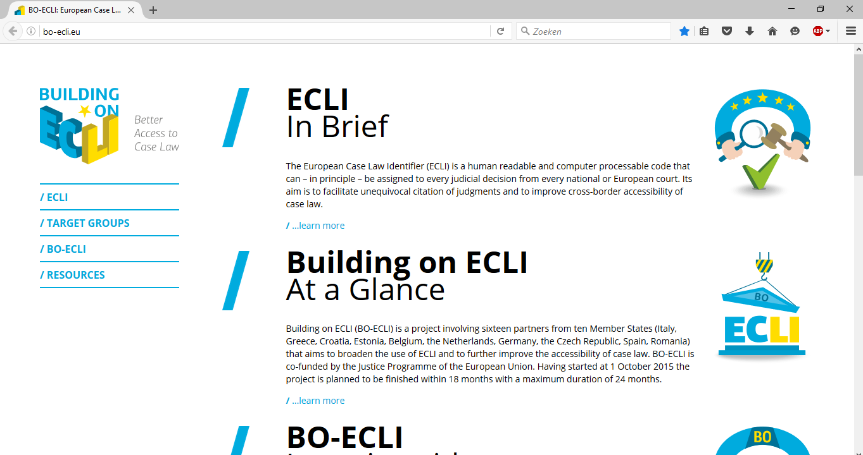
Thank you for your attention!
Comments, Questions, Debate
BO-ECLI
www.bo-ecli.eu | info@bo-ecli.eu
This presentation has been produced with the financial support of the Justice Programme of the European Union. The contents of this publication are the sole responsibility of the partners of the BO-ECLI project and can in no way be taken to reflect the views of the European Commission.
This project is co-funded by
the European Union

